Slide 1
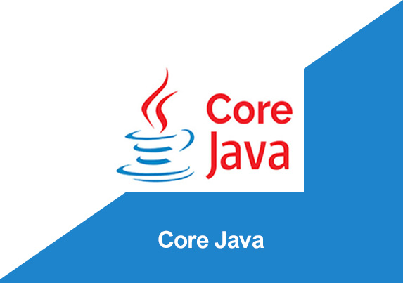
By: Manas Tuwani

Slide 2
What is an Exception in Java?
Dictionary Meaning: Exception is an abnormal condition.
An exception is an unwanted or unexpected event that occurs at the time of execution. It disrupts the normal flow of the program which often leads to termination of the program or application.
Exceptions in Java can occur due to several reasons like trying to access an element of an array with an index greater than the size of the array, trying to access a non-existing file in your program, invalid data input, network problems, etc. Fortunately, Java has a robust system for handling such errors to prevent the termination of the program.

Slide 3
What is Exception handling in Java?
Exception Handling in Java is one of the effective means to handle the runtime errors so that the regular flow of the application can be preserved. Java Exception Handling is a mechanism to handle runtime errors such as ClassNotFoundException, IOException, RemoteException, etc.
“The Exception Handling in Java is one of the powerful mechanism to handle the rutime errors so that the normal flow of the application can be maintained.’’

Slide 4
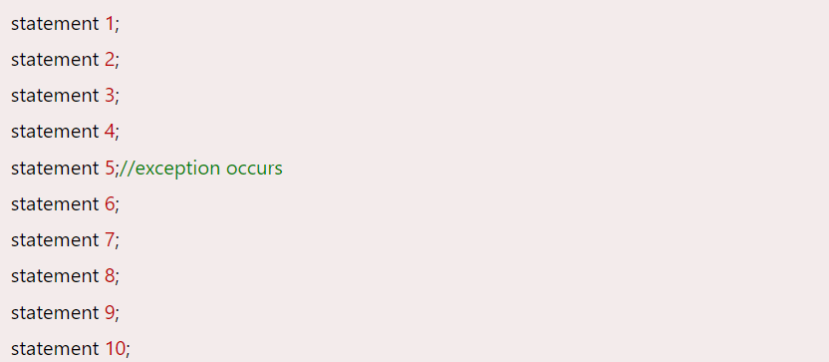
Advantage of Exception Handling
The core advantage of exception handling is to maintain the normal flow of the application. An exception normally disrupts the normal flow of the application; that is why we need to handle exceptions.
Suppose there are 10 statements in a Java program and an exception occurs at statement 5; the rest of the code will not be executed, i.e., statements 6 to 10 will not be executed. However, when we perform exception handling, the rest of the statements will be executed. That is why we use exception handling in JAVA.

Slide 5
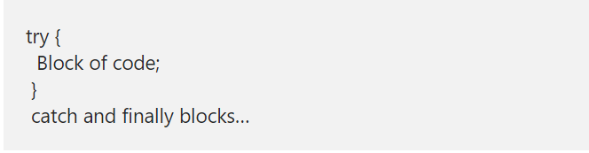
The Try Block
The first essential step to exception handling is to enclose the lines which can cause an exception, within the try block. The try block contains those lines which can cause an exception and can have one or more legal lines of code. If an exception occurs at a particular statement of the try block, the rest of the statements will not be executed. Thus, it is recommended to exclude those lines which won’t throw an exception. The try block syntax is:
A try block must always be followed by a catch block or finally block or both.

Slide 6
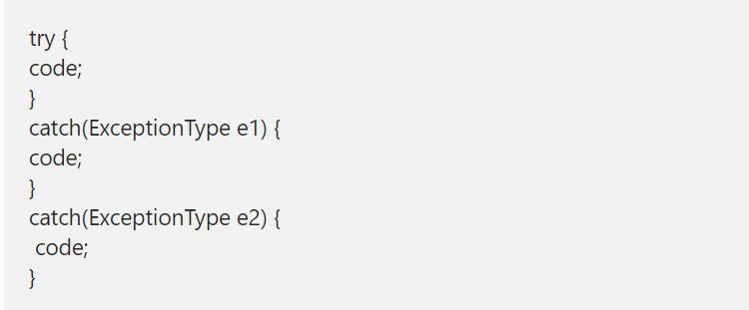
The Catch Block
The catch block is required to handle the exception. It contains lines of code that will be executed if an exception occurs. Each catch block is an exception handler that handles the type of exception specified by the argument.
To declare the exception type that the catch block will handle, we need to know the type of Exception that can be thrown by the JVM in the try block. The syntax of the catch block is:

Slide 7
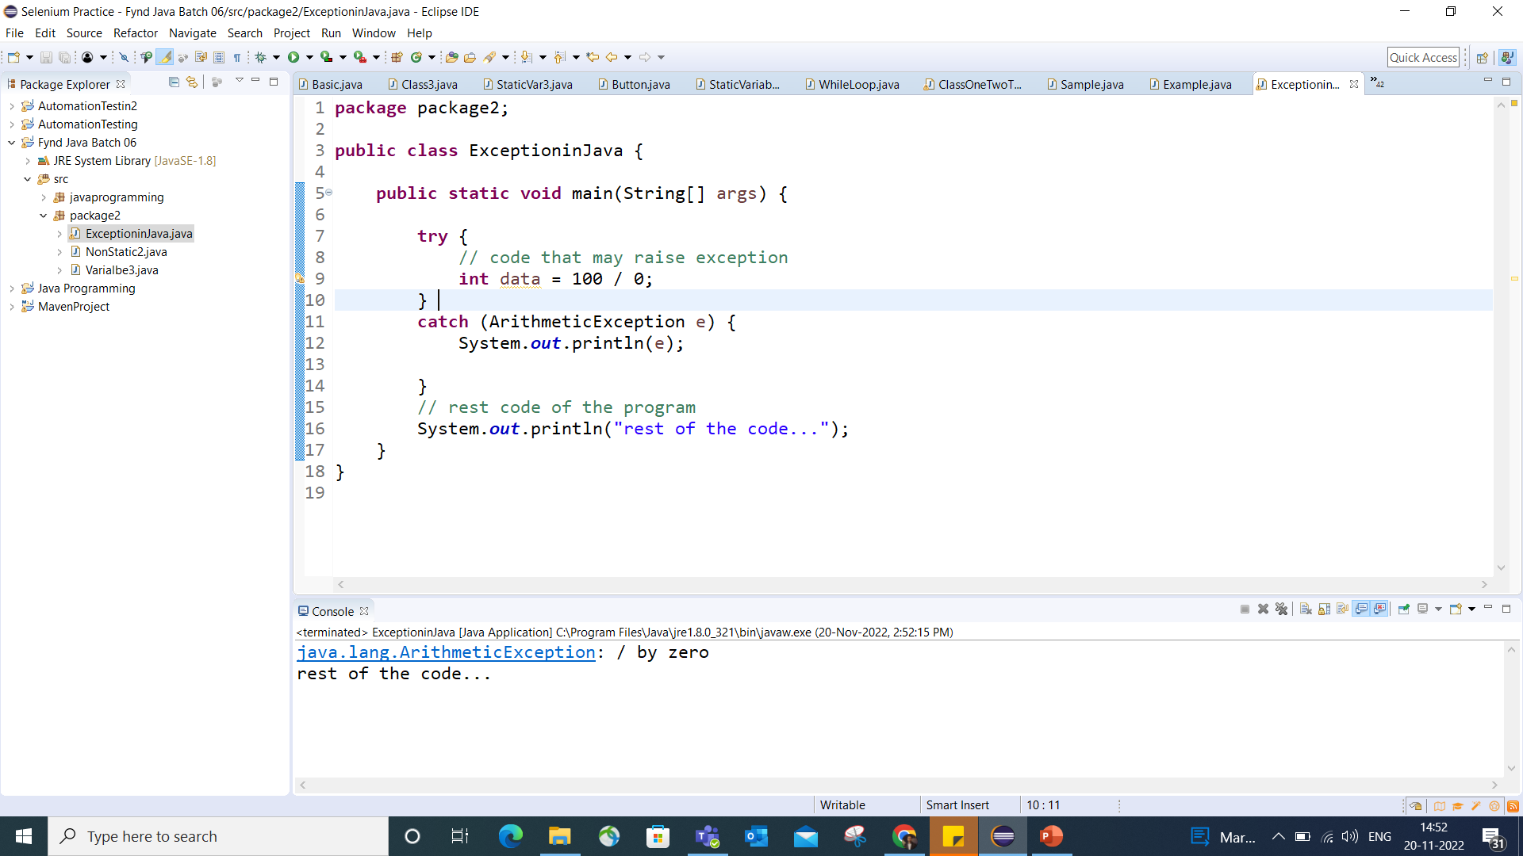

Slide 8
A few points to be remembered for the try-catch block are:
A single try block can have multiple catch blocks and the try block contains only those statements which can cause an exception.
Corresponding catch blocks are executed for that specific type of exception. Example- catch(ArithmeticException e) will handle only arithmetic exceptions, catch(NullPointException e) will handle only NullPointExceptions.
If no exception occurs, then all the catch blocks will be completely ignored.

Slide 9
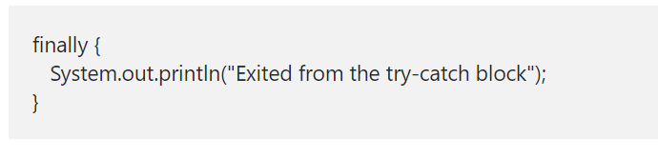
Finally block
The lines contained inside the ‘finally’ block will be executed whether or not an exception occurs. This block is written after the end of all the catch blocks.
The "finally" block is used to execute the necessary code of the program. It is executed whether an exception is handled or not.

Slide 10
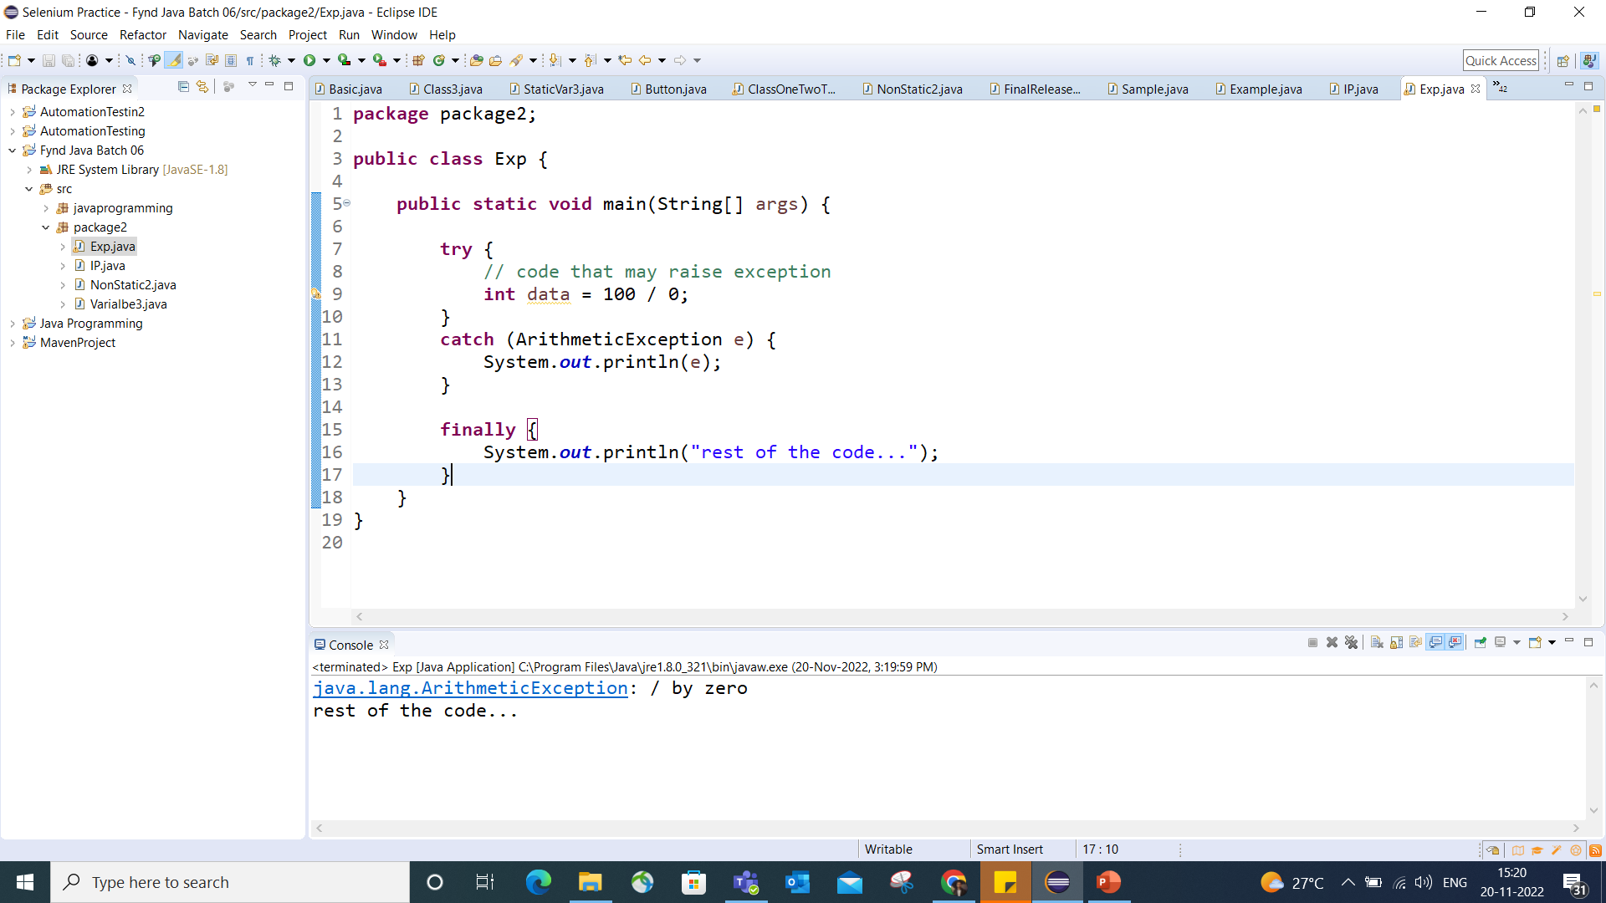

Slide 11
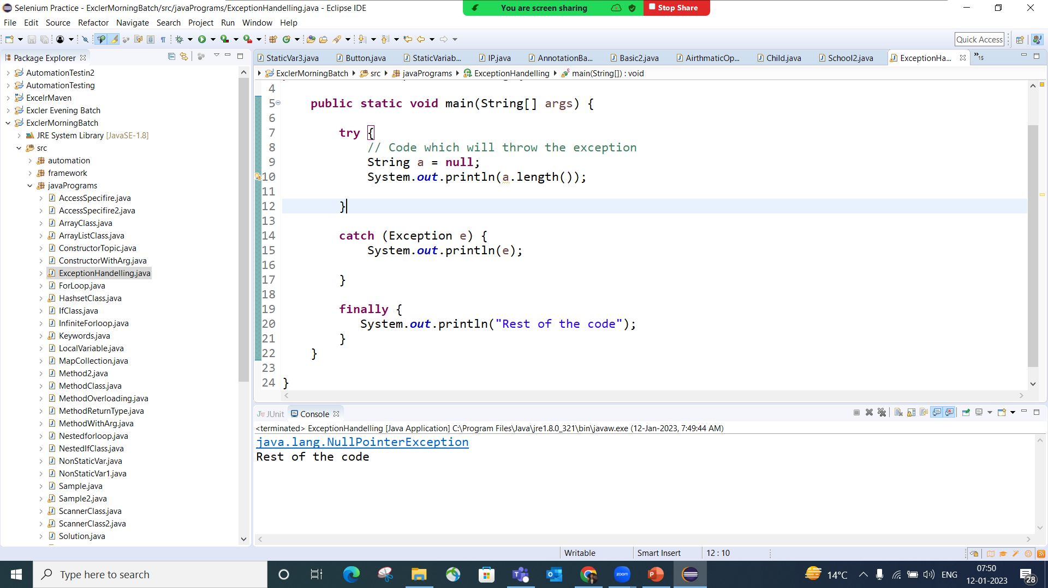

Slide 12
Common Scenarios of Java Exceptions
There are given some scenarios where unchecked exceptions may occur. They are as follows:
A scenario where ArithmeticException occurs
If we divide any number by zero, there occurs an ArithmeticException.
int a=50/0;
System.out.println(a) //ArithmeticException

Slide 13
2) A scenario where NullPointerException occurs
If we have a null value in any variable, performing any operation on the variable throws a NullPointerException.
String s=null;
System.out.println(s.length()); //NullPointerException

Slide 14
3) A scenario where ArrayIndexOutOfBoundsException occurs
When an array exceeds to its size, the ArrayIndexOutOfBoundsException occurs. there may be other reasons to occur ArrayIndexOutOfBoundsException. Consider the following statements.
int a[]=new int[5];
a[10]=50; //ArrayIndexOutOfBoundsException

Slide 15
4) StringIndexOutOfBoundsException
StringIndexOutOfBoundsException: Similar to the ArrayIndexOutOfBounds exception, this exception arises when a non-existent string index is accessed.
String s = “Manas”;
s.charAt(7); // StringIndexOutOfBoundsException

Slide 16
5) FileNotFoundException
FileNotFoundException: This exception occurs when an attempt to open a file denoted by a specified pathname has failed.
FileInputStream f = new FileInputStream("C:\\Users\\Desktop\\Inputdata.xls");
Note: This error will occur if Inputdata.xls file is not present in above location

Slide 17
6) IOException
This exception occurs when there has been a failure in the input/output operations.

Slide 18
Throws Keyword
The throws keyword is used to indicate that a particular method may throw an exception of a specific type. The caller of this method has to handle the exception using a try-catch block. The throws keyword declares an exception and if not handled, could cause compilation
public static void main(String[] args) throws Exception {
}

Slide 19
Throw Vs Throws Keyword
Java throw keyword is used throw an exception explicitly in the code, inside the function or the block of code.
public static void checkNum(int num) {
if (num < 1) {
throw new ArithmeticException("Number is negative, cannot calculate square"); }
Whereas Java throws keyword is used in the method signature to declare an exception which might be thrown by the function while the execution of the code.
public static void main(String[] args) throws Exception {
}

